Slide 1
Module 15: Cryptographic Services
Networking Security v1.0
(NETSEC)
Notes:
Networking Security (NETSEC) Module 15: Cryptographic Services

Slide 2
Module Objectives
Module Title: Cryptographic Services
Module Objective: Explain how the types of encryption, hashes, and digital signatures work together to provide confidentiality, integrity, and authentication.
Topic Title | Topic Objective
Secure Communications | Explain the requirements of secure communications including integrity, authentication, and confidentiality.
Cryptography | Describe cryptography.
Cryptanalysis | Describe cryptanalysis.
Cryptology | Describe cryptology.
Notes:
2
15 – Cryptographic Services
15.0.2 – What will I learn to do in this module?

Slide 3
15.1 Secure Communications
Notes:
15: Cryptographic Services 15.1: Secure Communications

Slide 4
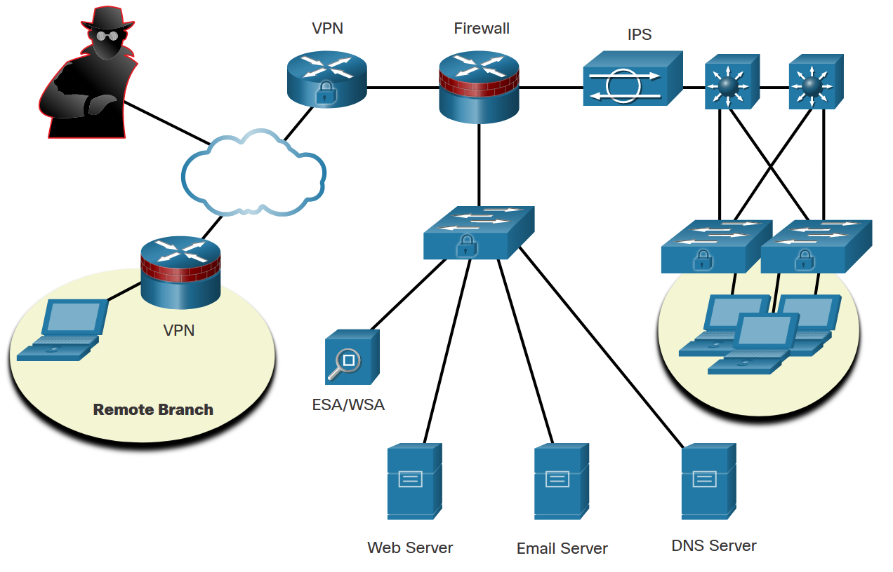
Secure Communications
Authentication, Integrity, and Confidentiality
To ensure secure communications across both the public and private infrastructure, the network administrator’s first goal is to secure the network infrastructure, including routers, switches, servers, and hosts.
The figure shows an example of a secure network topology.
There are three primary objectives of securing communications:
Authentication
Integrity
Confidentiality
Notes:
15: Cryptographic Services 15.1: Secure Communications 15.1.1: Authentication, Integrity, and Confidentiality

Slide 5
Secure Communications
Authentication
There are two primary methods for validating a source in network communications: authentication services and data nonrepudiation services.
In network communications, authentication can be accomplished using cryptographic methods.
Data nonrepudiation is a similar service that allows the sender of a message to be uniquely identified. With nonrepudiation services in place, a sender cannot deny having been the source of that message.
Notes:
15: Cryptographic Services 15.1: Secure Communications 15.1.2: Authentication

Slide 6
Secure Communications
Data Integrity
Data integrity ensures that messages are not altered in transit. With data integrity, the receiver can verify that the received message is identical to the sent message and that no manipulation occurred.
Notes:
15: Cryptographic Services 15.1: Secure Communications 15.1.3: Data Integrity

Slide 7
Secure Communications
Data Confidentiality
Data confidentiality ensures privacy so that only the receiver can read the message. This can be achieved through encryption. Encryption is the process of scrambling data so that it cannot be easily read by unauthorized parties.
When enabling encryption, readable data is called plaintext, or cleartext, while the encrypted version is called encrypted text or ciphertext. The plaintext readable message is converted to ciphertext, which is the unreadable, disguised message. Decryption reverses the process. A key is required to encrypt and decrypt a message. The key is the link between the plaintext and ciphertext.
Using a hash function is another way to ensure data confidentiality. A hash function transforms a string of characters into a usually shorter, fixed-length value or key that represents the original string. The difference between hashing and encryption is in how the data is stored.
Notes:
15: Cryptographic Services 15.1: Secure Communications 15.1.4: Data Confidentiality
15.1.5: Check Your Understanding - Identify the Secure Communication Objective

Slide 8
15.2 Cryptography
Notes:
15: Cryptographic Services 15.2: Cryptography

Slide 9
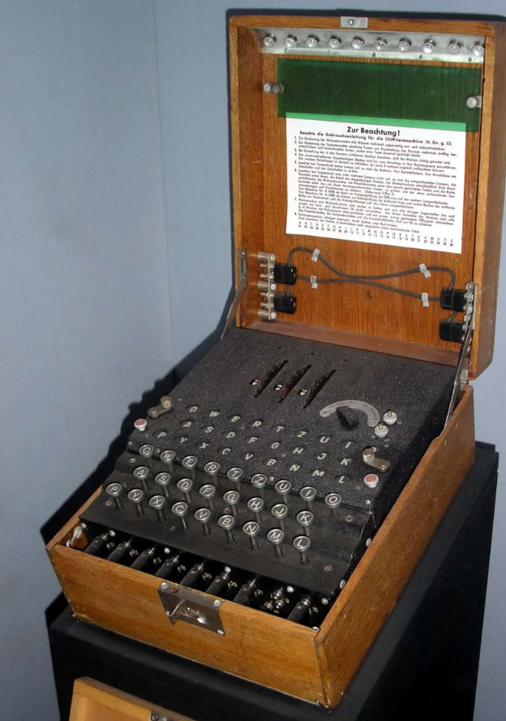
Cryptography
Creating Cipher Text
The history of cryptography starts in diplomatic circles thousands of years ago. Messengers from a king’s court took encrypted messages to other courts. Occasionally, other courts not involved in the communication, attempted to steal messages sent to a kingdom they considered an adversary. Not long after, military commanders started using encryption to secure messages.
The Enigma machine was an electromechanical encryption device that was developed and used by Nazi Germany during World War II. The device depended on the distribution of pre-shared keys that were used to encrypt and decrypt messages. The figure is an example of an Enigma machine.
Notes:
15: Cryptographic Services 15.2: Cryptography 15.2.1: Creating Cipher Text

Slide 10
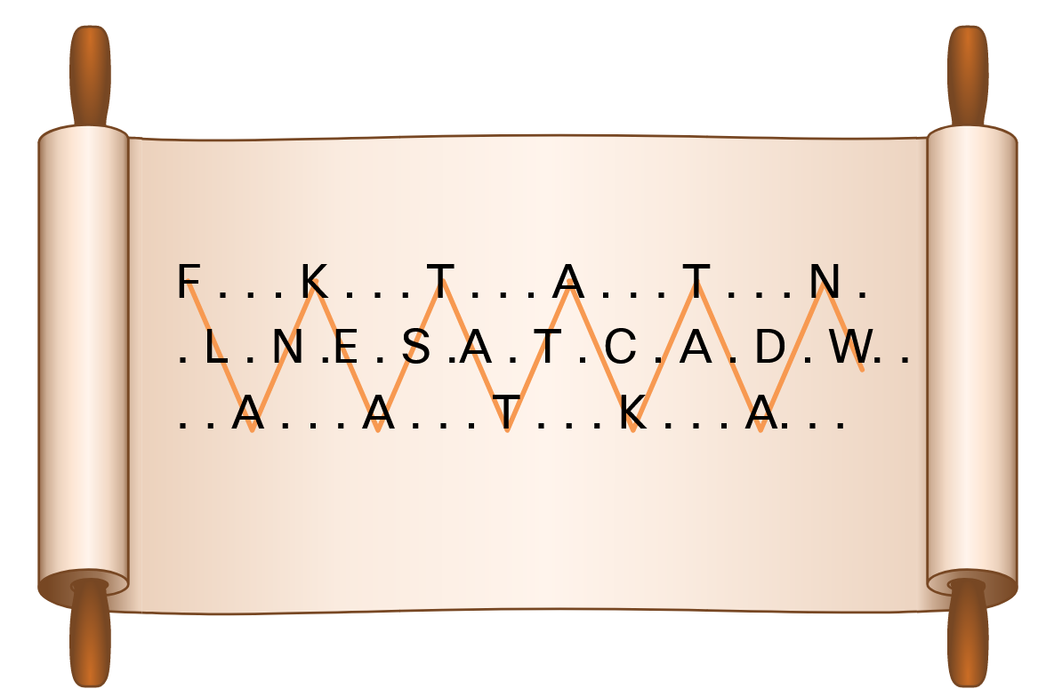
Cryptography
Transposition Ciphers
In transposition ciphers, no letters are replaced; they are simply rearranged. An example of this type of cipher is taking the FLANK EAST ATTACK AT DAWN message and transposing it to read NWAD TA KCATTA TSAE KNALF. In this example, the key is to reverse the letters.
Another example of a transposition cipher is known as the rail fence cipher. In this transposition, the words are spelled out as if they were a rail fence. They are staggered, some in front, some in the middle and some in back, across several parallel lines. An example is shown in the figure.
Modern encryption block cipher algorithms, such as AES and the legacy 3DES, still use transposition as part of the algorithm.
Notes:
15: Cryptographic Services 15.2: Cryptography 15.2.2: Transposition Ciphers

Slide 11
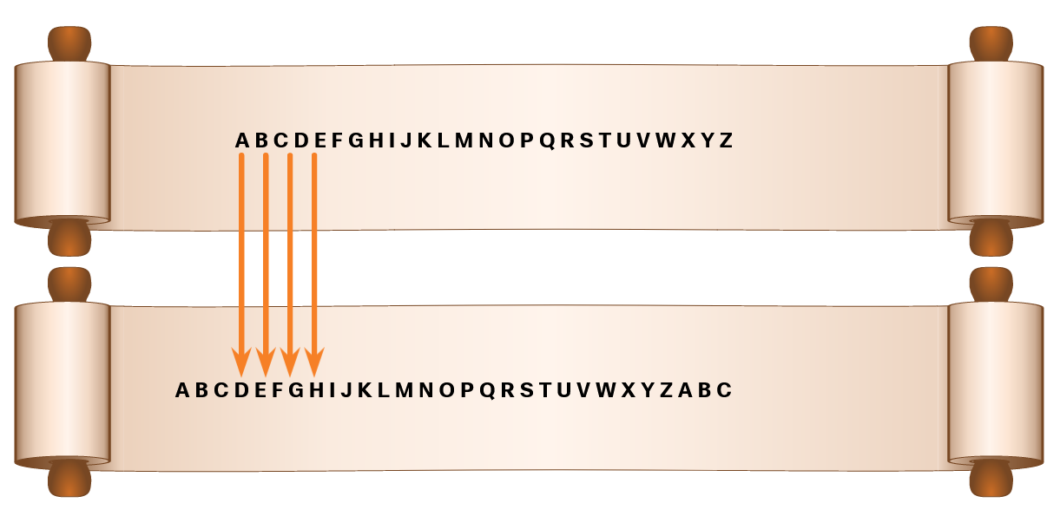
Cryptography
Substitution Ciphers
Substitution ciphers substitute one letter for another. In their simplest form, substitution ciphers retain the letter frequency of the original message.
Notes:
15: Cryptographic Services 15.2: Cryptography 15.2.3: Substitution Ciphers

Slide 12

Cryptography
A More Complex Substitution Cipher
The Vigenère cipher is based on the Caesar cipher, except that it encrypts text by using a different polyalphabetic key shift for every plaintext letter. The different key shift is identified using a shared key between sender and receiver. The plaintext message can be encrypted and decrypted using the Vigenère Cipher Table that is shown in the figure.
Notes:
15: Cryptographic Services 15.2: Cryptography 15.2.4: A More Complex Substitution Cipher

Slide 13
Cryptography
A More Complex Substitution Cipher (Cont.)
To illustrate how the Vigenère Cipher Table works, suppose that a sender and receiver have a shared secret key composed of these letters: SECRETKEY. The sender uses this secret key to encode the plaintext FLANK EAST ATTACK AT DAWN:
The F (FLANK) is encoded by looking at the intersection of column F and the row starting with S (SECRETKEY), resulting in the cipher letter X.
The L (FLANK) is encoded by looking at the intersection of column L and the row starting with E (SECRETKEY), resulting in the cipher letter P.
The A (FLANK) is encoded by looking at the intersection of column A and the row starting with C (SECRETKEY), resulting in the cipher letter C.
The N (FLANK) is encoded by looking at the intersection of column N and the row starting with R (SECRETKEY), resulting in the cipher letter E.
The K (FLANK) is encoded by looking at the intersection of column K and the row starting with E (SECRETKEY), resulting in the cipher letter O.
For example, SECRETKEYSECRETKEYSEC is required to encode FLANK EAST ATTACK AT DAWN:
Secret key: SECRETKEYSECRETKEYSEC
Plaintext: FLANKEASTATTACKATDAWN
Cipher text: XPCEOXKURSXVRGDKXBSAP
Notes:
15: Cryptographic Services 15.2: Cryptography 15.2.4: A More Complex Substitution Cipher

Slide 14
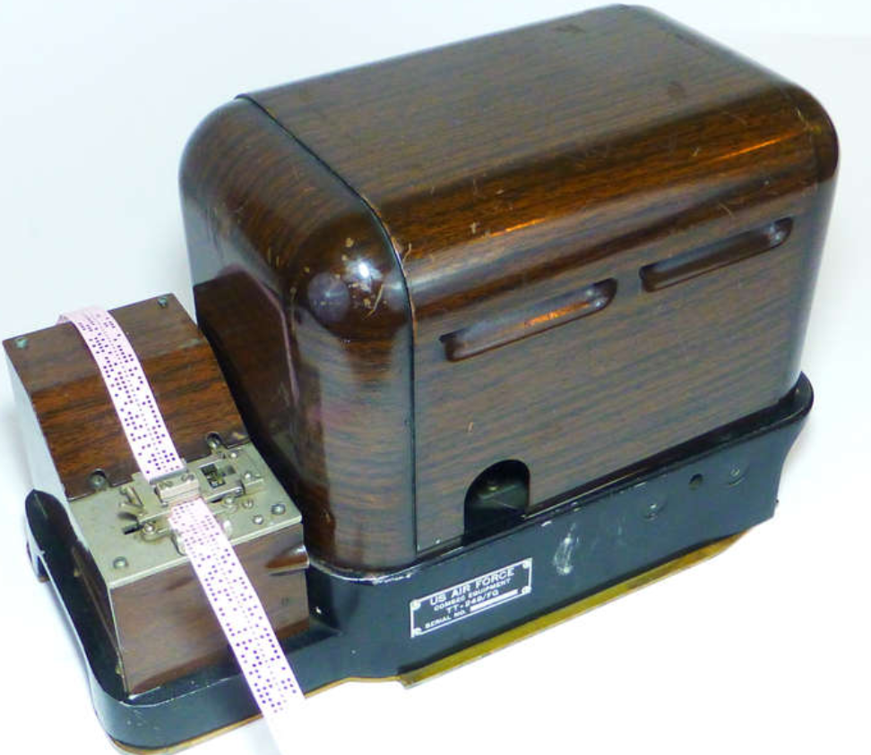
Cryptography
One-Time Pad Ciphers
Gilbert Vernam was an AT&T Bell Labs engineer who, in 1917, invented, and later patented, the stream cipher. He also co-invented the one-time pad cipher. Vernam proposed a teletype cipher in which a prepared key consisting of an arbitrarily long, non-repeating sequence of numbers was kept on paper tape, shown in the figure. It was then combined character by character with the plaintext message to produce the ciphertext.
To decipher the ciphertext, the same paper tape key was again combined character by character, producing the plaintext. Each tape was used only once; hence, the name one-time pad. Several difficulties are inherent in using one-time pads in the real world.
Notes:
15: Cryptographic Services 15.2: Cryptography 15.2.5: One-Time Pad Ciphers

Slide 15
15.3 Cryptanalysis
Notes:
15: Cryptographic Services 15.3: Cryptanalysis

Slide 16
Cryptanalysis
Cracking Code
Cryptanalysis is the practice and study of determining the meaning of encrypted information (cracking the code), without access to the shared secret key. This is also known as codebreaking.
Throughout history, there have been many instances of cryptanalysis:
The Vigenère cipher had been absolutely secure until it was broken in the 19th century by English cryptographer Charles Babbage.
Mary, Queen of Scots, was plotting to overthrow Queen Elizabeth I from the throne and sent encrypted messages to her co-conspirators. The cracking of the code used in this plot led to the beheading of Mary in 1587.
The Enigma-encrypted communications were used by the Germans to navigate and direct their U-boats in the Atlantic. Polish and British cryptanalysts broke the German Enigma code. Winston Churchill was of the opinion that it was a turning point in WWII.
Notes:
15: Cryptographic Services 15.3: Cryptanalysis 15.3.1: Cracking Code

Slide 17
Cryptanalysis
Methods of Cracking Code
Several methods are used in cryptanalysis:
Brute-force method - The attacker tries every possible key knowing that eventually one of them will work.
Ciphertext method - The attacker has the ciphertext of several encrypted messages but no knowledge of the underlying plaintext.
Known-Plaintext method - The attacker has access to the ciphertext of several messages and knows something about the plaintext underlying that ciphertext.
Chosen-Plaintext method - The attacker chooses which data the encryption device encrypts and observes the ciphertext output.
Chosen-Ciphertext method - The attacker can choose different ciphertext to be decrypted and has access to the decrypted plaintext.
Meet-in-the-Middle method - The attacker knows a portion of the plaintext and the corresponding ciphertext.
Notes:
15: Cryptographic Services 15.3: Cryptanalysis 15.3.2: Methods of Cracking Code

Slide 18
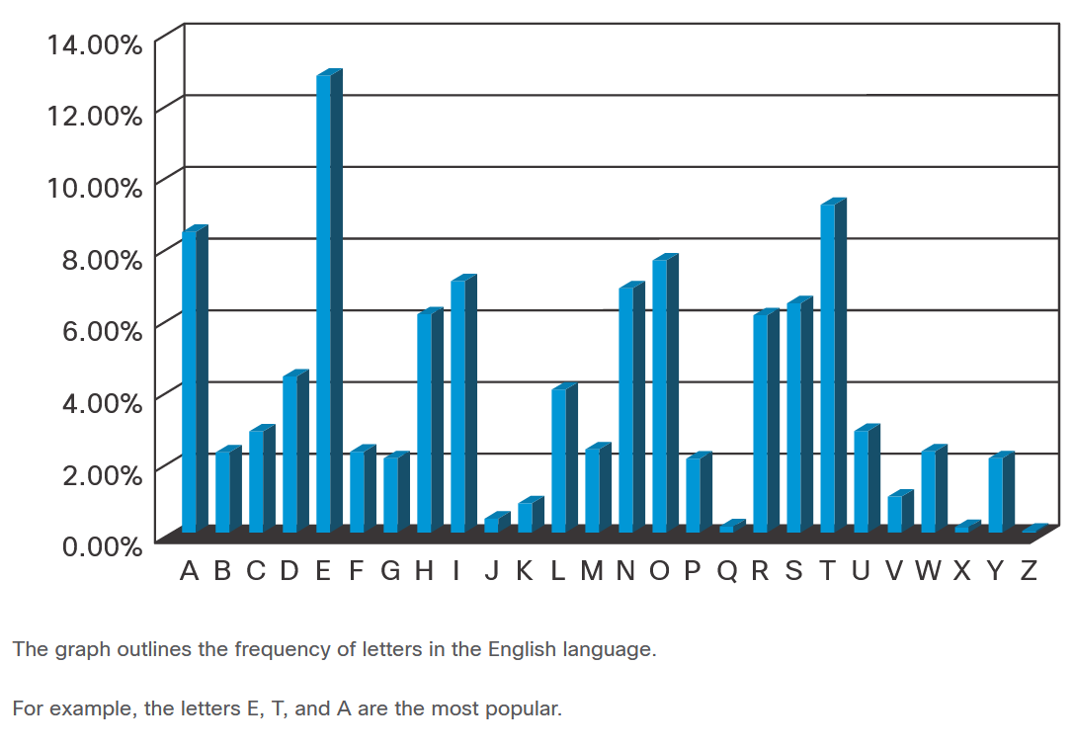
Cryptanalysis
Cracking Code Example
When choosing a cryptanalysis method, consider the Caesar cipher encrypted code. The best way to crack the code is to use brute force. Because there are only 25 possible rotations, the effort is relatively small to try all possible rotations and see which one returns something that makes sense.
A more scientific approach is to use the fact that some characters in the English alphabet are used more often than others. This method is called frequency analysis.
Notes:
15: Cryptographic Services 15.3: Cryptanalysis 15.3.3: Cracking Code Example
15.3.4: Check your Understanding- Crack the Code

Slide 19
15.4 Cryptology
Notes:
15: Cryptographic Services 15.4: Cryptology

Slide 20
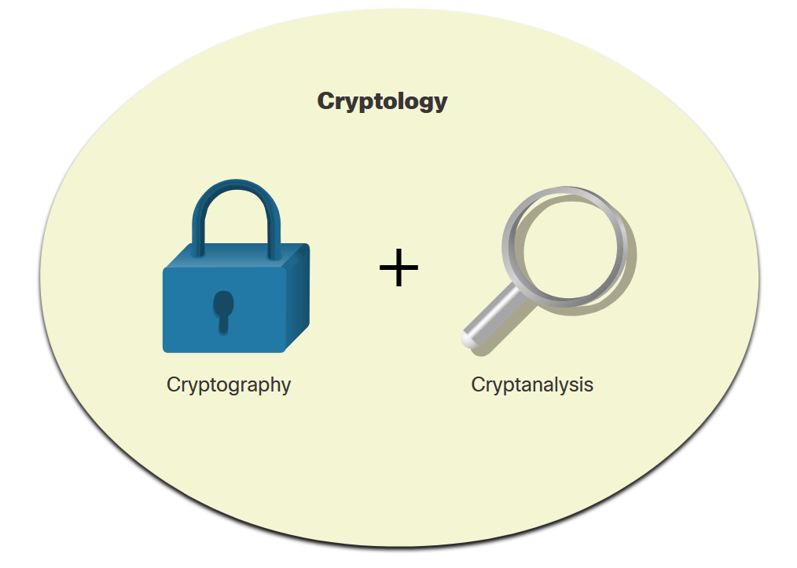
Cryptology
Making and Breaking Secret Codes
Cryptology is the science of making and breaking secret codes. As shown in the figure, cryptology combines two separate disciplines:
Cryptography - the development and use of codes
Cryptanalysis - the breaking of those codes
There is a symbiotic relationship between the two disciplines because each makes the other one stronger. National security organizations employ practitioners of both disciplines and put them to work against each other.
Notes:
15: Cryptographic Services 15.4: Cryptology 15.4.1: Making and Breaking Secret Codes

Slide 21
Cryptology
Cryptanalysts
Cryptanalysis is often used by governments in military and diplomatic surveillance, by enterprises in testing the strength of security procedures, and by malicious hackers in exploiting weaknesses in websites.
Cryptanalysts are individuals who perform cryptanalysis to crack secret codes. A sample job description is displayed in the figure.
While cryptanalysis is often linked to mischievous purposes, it is actually a necessity. It is an ironic fact of cryptography that it is impossible to prove that any algorithm is secure. It can only be proven that it is not vulnerable to known cryptanalytic attacks. Therefore, there is a need for mathematicians, scholars, and security forensic experts to keep trying to break the encryption methods.
Notes:
15: Cryptographic Services 15.4: Cryptology 15.4.2: Cryptanalysts

Slide 22
Cryptology
The Secret is in the Keys
In the world of communications and networking, authentication, integrity, and data confidentiality are implemented in many ways using various protocols and algorithms. The choice of protocol and algorithm varies based on the level of security required to meet the goals of the network security policy.
The table lists some common cryptographic hashes, protocols, and algorithms.
Integrity | Authenticity | Confidentiality
MD5 (legacy) | HMAC-MD5 (legacy) | 3DES (legacy)
SHA | HMAC-SHA-256 | AES
 | RSA and DSA
Notes:
15: Cryptographic Services 15.4: Cryptology 15.4.3: The Secret is in the Keys
15.4.4: Check Your Understanding - Cryptology Terminology

Slide 23
Cryptology
Lab - Exploring Encryption Methods
In this lab, you will complete the following objectives:
Part 1: Decipher a pre-encrypted message using the Vigenère cipher.
Part 2: Create a Vigenère cipher encrypted message and decrypt it.
Notes:
15: Cryptographic Services 15.4: Cryptology 15.4.5: Lab - Exploring Encryption Methods

